Slide 1
SPORTS REHABILIATION COACH
6th Semester
MINI PROJECT / 21ECMP67
1JS21EC062: Kalpana R
1JS21EC079:Manoj K
1JS21EC082: M Harshavardhan
1JS21EC086: Namratha G K
Guide Name :
DR. P M SHIVAKUMARA SWAMY
Designation :
PROFESSOR,
Head of Dept Electronics and Communication

Slide 2
Introduction
Literature Survey
Problem Statement
Objectives
Methodology
Proposed Work (Block diagram)
Work Plan
Expected Result
References

Slide 3
INTRODUCTION
Overview: Our project aims to develop a comprehensive website for sports injury rehabilitation coach, integrating advanced technologies to enhance rehabilitation practices.
Importance: Effective rehabilitation is crucial for athlete recovery and performance, reducing downtime and preventing re-injury.

Slide 4
Literature Survey
Current Technologies: Basic rehab apps, Sports physiotherapy websites, Doctor consultation websites
Challenges: Lack of real-time feedback, limited customization, and poor integration of data, Financial barriers, No user friendly website.
Insights: Research indicates a need for more sophisticated tools that provide personalized and real-time support.

Slide 5
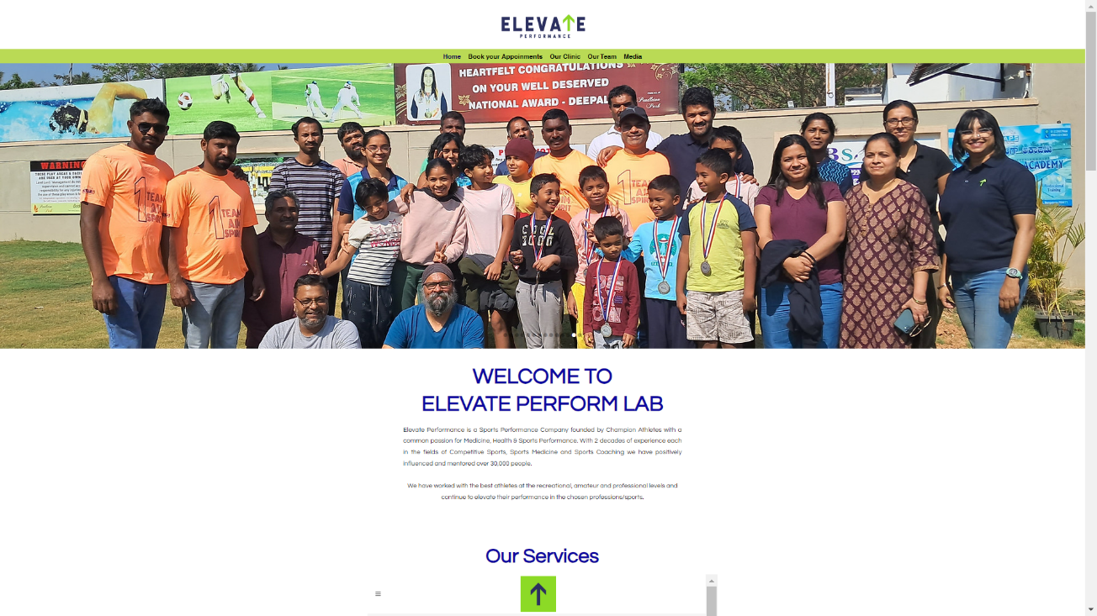
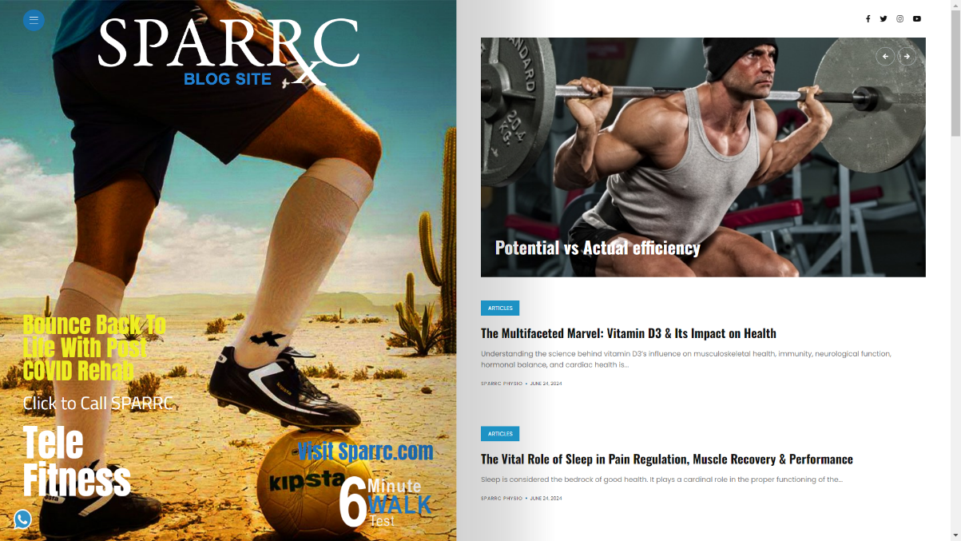
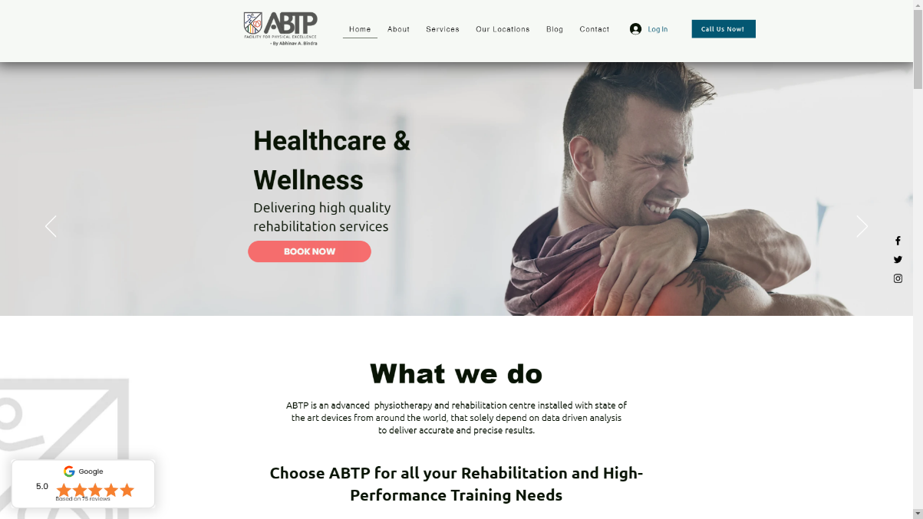
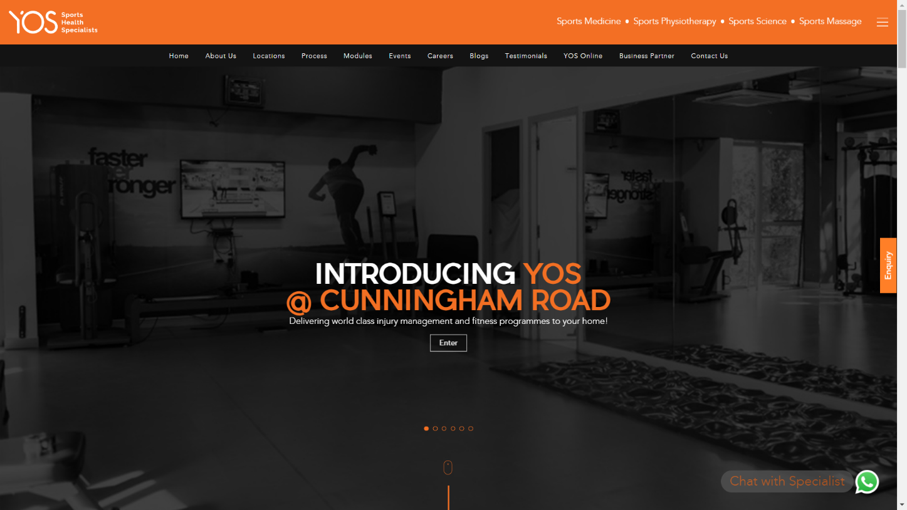

Slide 6
Prevalence of Injuries: Approximately 30% of professional athletes experience significant injuries each year.
Gaps in Solutions: Existing tools often lack integration and fail to provide comprehensive support tailored to individual athlete needs.
Research shows that only 2-3% of sports injuries are reported, leaving 97% unnoticed. This gap highlights a critical issue in effectively managing and addressing sports injuries.
Problem Statement

Slide 7
Prevalence of Injuries: Approximately 30% of professional athletes experience significant injuries each year.

Slide 8
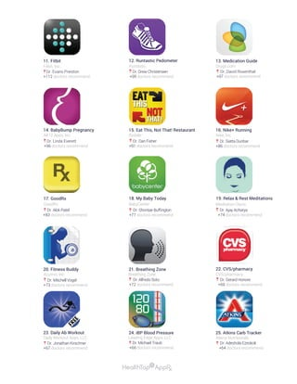
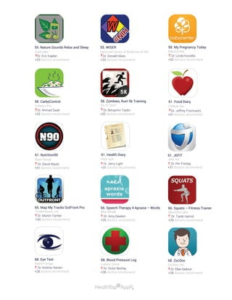
Prevalence of Injuries: Approximately 30% of professional athletes experience significant injuries each year.
Gaps in Solutions: Existing tools often lack integration and fail to provide comprehensive support tailored to individual athlete needs.
Problem Statement
Needs of Coaches: Coaches require reliable data, real-time feedback, and effective communication tools to support athletes.
Research shows that only 2-3% of sports injuries are reported, leaving 97% unnoticed. This gap highlights a critical issue in effectively managing and addressing sports injuries.

Slide 9
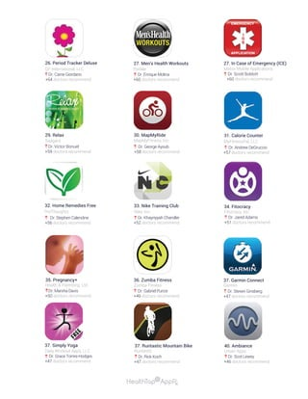
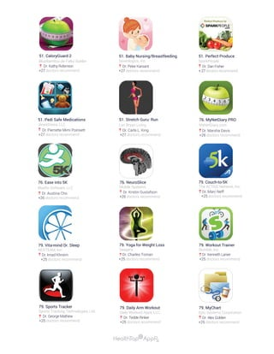
Gaps in Solutions: Existing tools often lack integration and fail to provide comprehensive support tailored to individual athlete needs.

Slide 10
Research shows that only 2-3% of sports injuries are reported, leaving 97% unnoticed. This gap highlights a critical issue in effectively managing and addressing sports injuries.
There were about 570,000 Basketball related injuries seen by emergency rooms across the country, with over 8,000 requiring hospitalization.
There were about 466,000 visits to the Hospital rooms due to Football injuries,
Only 10,000 of them required overnight stays .
There were approximately 265,000 Injuries related to baseball and softball, with over 4,500 requiring hospitalization.

Slide 11
Objectives
User-Friendly Platform: Create an intuitive and easy-to-navigate website.
Real-Time Monitoring: Enable coaches to seek guidance and remain updated.
Personalized Plans: Offer customizable rehabilitation plans based on individual athlete needs.
Improved Communication: Provide secure and efficient communication channels for coaches and athletes.

Slide 12

Services Offered
1. Physical Therapy
2. Massage Therapy
3. Injury Prevention
4. Fast relief
5. Accurate guidance

Slide 13

Methodology
Website Development:
Research: Understand the needs of people.
Design: Create wireframes and design the user interface.
Development: Build the website using modern web development technologies.
Testing: Perform usability and functionality testing.
Launch: Deploy the website and provide training for users.

Slide 14


Methodology
Features:Dashboard: Comprehensive overview of user status and progress.
Tracking Tools: Tools for monitoring injury recovery metrics.
Communication: Messaging system for user interaction.

Slide 15
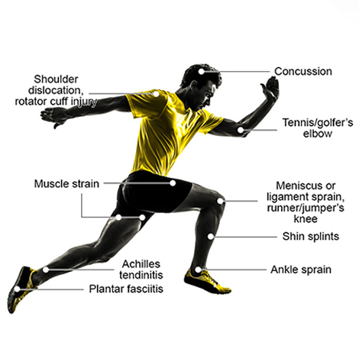
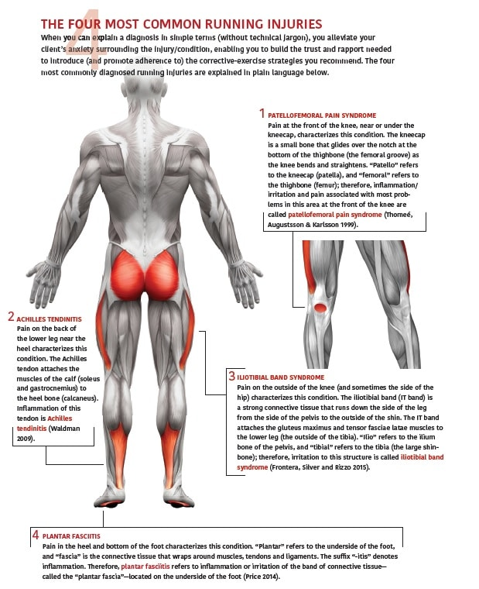
Common Injuries

Slide 16
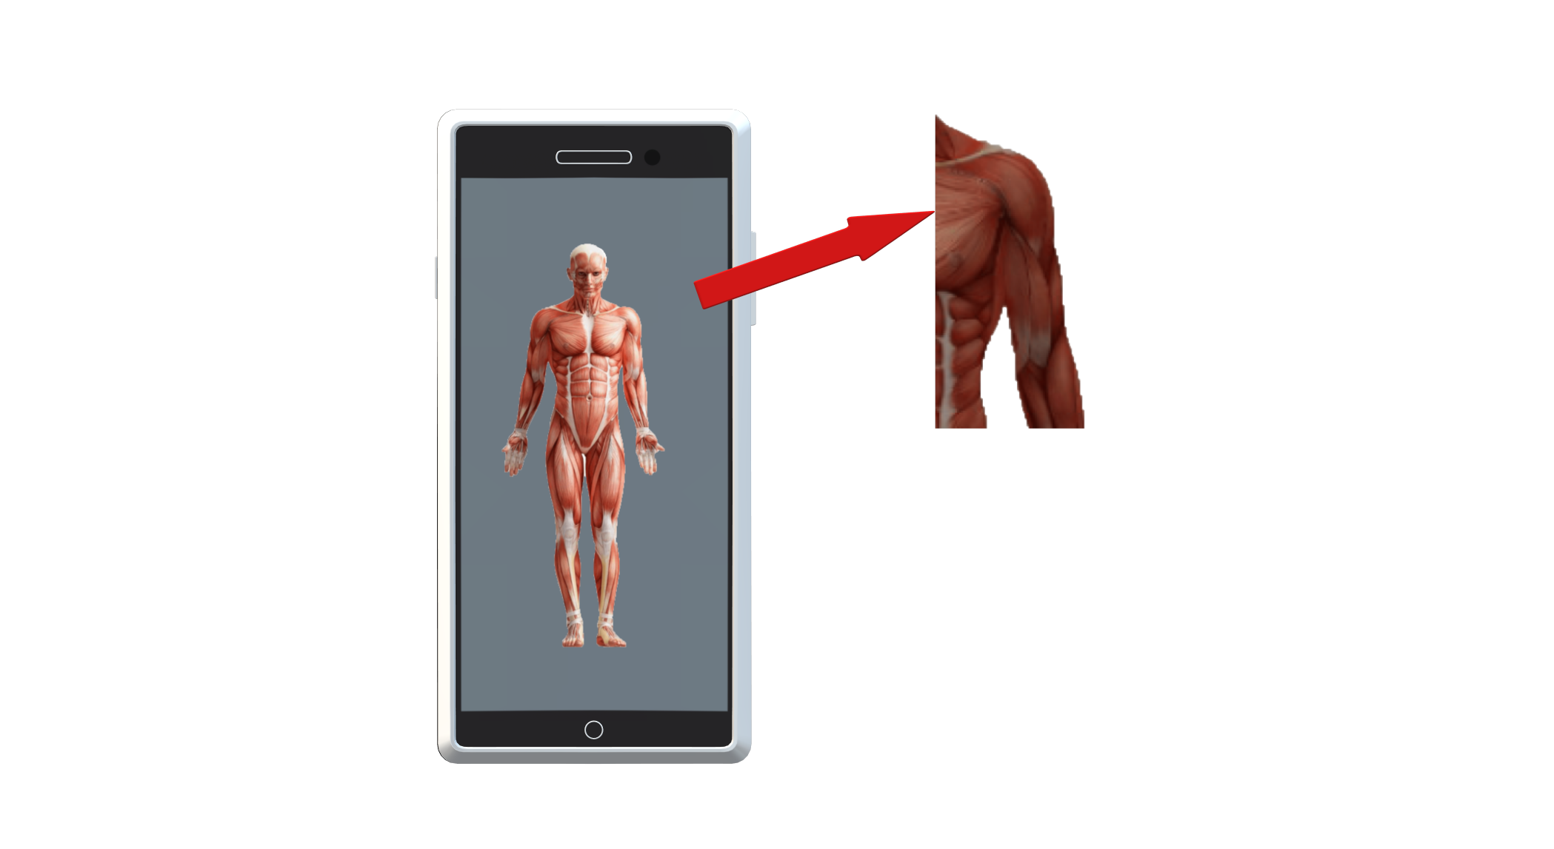


EXPECTED OUTCOME

Slide 17

SHOULDER PAIN:
- Cause:
Basketball
Base ball
Tennis
-REMEDIES
Rest your shoulder
Put an ice pack upon it to relieve pain.
If the pain gets worse, please consult nearby doctor.
EXPECTED OUTCOME

Slide 18
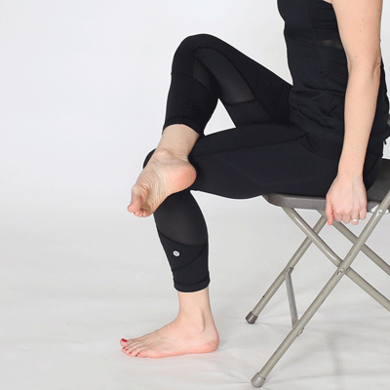
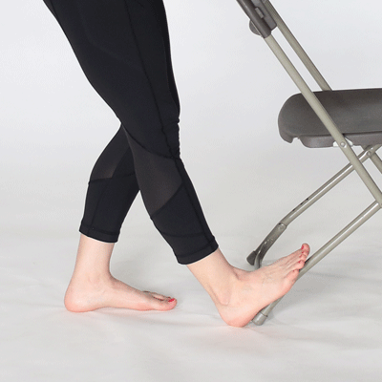
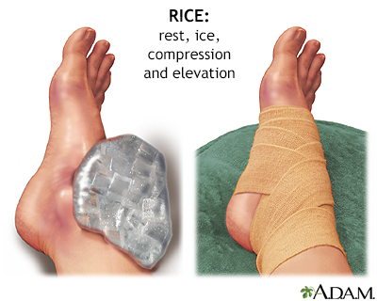
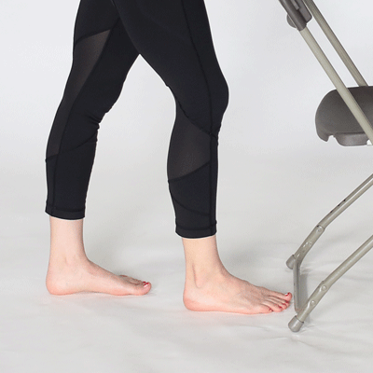
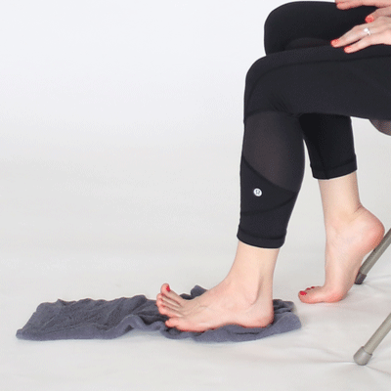
Ankle Sprains

Slide 19
References:
https://yellow.ai/ -
https://app.fyndbetter.com/
- https://www.wix.com/scheduling-software https://business.whatsapp.com/
https://jipsi.in/service/sports-injury-management
Chat Gpt 3.5

